Slide 2
Minor - 2
End-Term Presentation
on
Foot Traffic Analysis for Optimal Restaurants Operations
Project Guide
Ms. Amber Hayat
Assistant Professor(SG),
School of Computer Science (Department of Systemics)

Slide 3
TEAM MEMBERS AND ROLE
NAME | ENROLL.NO. | ROLE
Ishika Jain | R164217022 | DOCUMENTATION AND CODING
Krishan Kant | R164217027 | DOCUMENTATION AND CODING
Nihit Garg | R164217033 | DOCUMENTATION AND CODING

Slide 4
ABSRACT
This project aims at developing, a set of data collection from the Restaurants and analyzing system for Restaurants foot traffic. Our data has been collected from the data of the billing receipts in the restaurants such as time of order, type of ordered food etc. This type of data is centrally processed and analyzed to predict that at what period of time in the day the crowd is maximum, average and minimum and what type of food is being mostly liked by the people at what time.

Slide 5
INTRODUCTION
The basic aim of this project is to analyze foot traffic based on historical data also we aim to analyze monthly and this contains the billing receipt data of every customer. After pre-processing the raw data, we built a model that gives total report of the last month to the manager of the restaurant such that they can optimize the restaurant operations.
For example, When the Manager want to check the progress report from the last month they can easily analyse it through this system.
Foot Traffic analysing system is the kind of Data analysis system which analyse the billing receipt of the restaurants and process it and then generate the reports for the optimal restaurant operations.

Slide 6
PROBLEM STATEMENT
The purpose of Foot Traffic analysis is mainly to diminish the problems like:
Lost sales tracking, which helps businesses plan inventory. If selling a certain type of dish was poor during peak foot traffic hours, that dish might not be worth selling.
How much time spent in the restaurants or the average time spent by customers. Data showing time spent in the restaurants combined with the time of day, week, or year can provide critical insight to customer buying patterns and interests.
Numbers and what type of dishes are buying by the customers.

Slide 7
OBJECTIVE
To give easy analysing strategy to the restaurant managers.
To analyse the customer interest ex:-what type of dishes are most ordered by the customers.
To give the optimal solutions to the Restaurants operation problems

Slide 8
Methodology
We’re deploying a restaurant management system where we can manage Items, Order, Employee along with the prediction system where we can fetch data from the database as entered by the user and accordingly make suggestions.
For analysing the data we are using Greedy Algorithm specifically 0/1 Knapsack Problem. We’re using this algorithm for calculating maximum and minimum frequency, for example frequency of number of dishes sold and then using the output for the prediction.

Slide 9
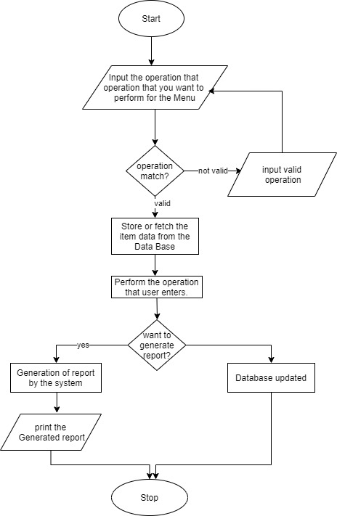
METHODOLOGY FLOW CHART

Slide 10
RESULTS & DISCUSSIONS
This system takes the various types of inputs from the user like name and id of dishes or item, quantity, prices etc. and then store it in .txt file. It also monitors labor working in the restaurant, orders placed and store it.
Furthermore, this project will be able to processes the data stored and give information like, top 10 ordered dishes and least ordered dishes from the last few weeks, which dish is ordered in the certain intervals of time in a day.
At the end it will generate the report to the manager containing suggestions such as: at what time in a day the restaurant requires less staff or more. Report also give suggestion about the amount of food need to be pre-prepared according to the people ordering in that interval of time.
The whole storage system would be transported to DBMS for better storage facilities.

